Slide 1

Machine Learning Overview, EDA and Clustering
Brian Wright
brianwright@virginia.edu

Slide 2
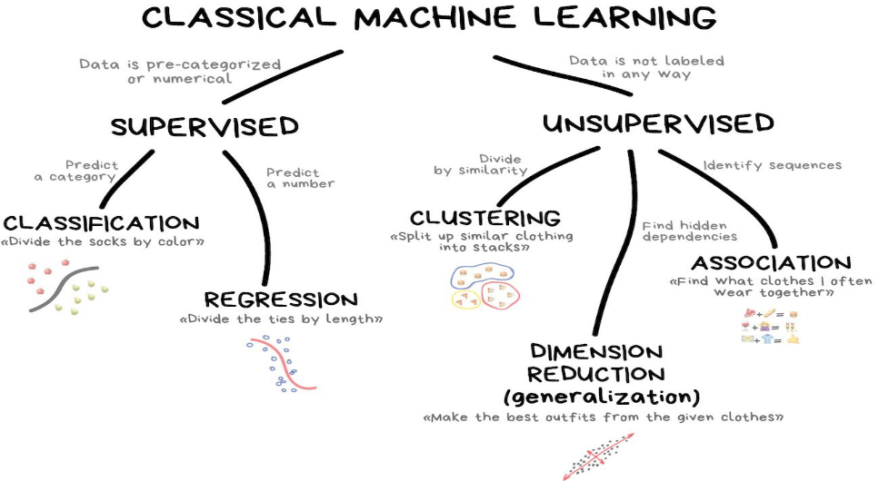

Slide 3
Write out the steps in kMeans Clustering in your own words

Slide 4
Example of K-Means
Given D :{2,4,10,12,3,11,20,25,30}, and k=2 clusters
Randomly assign the means: m₁=3, m₂=4
K₁={2,3}, K₂={4,10,12,11,20,25,30}, m₁=2.5, m₂=16
K₁={2,3,4}, K₂={10,12,11,20,25,30}, m₁=3, m₂=18
K₁={2,3,4,10}, K₂={12,11,20,25,30}, m₁=4.75, m₂=19.6
K₁={2,3,4,10,11,12}, K₂={20,25,30}, m₁=7, m₂=25
K₁={2,3,4,10,11,12}, K₂={20,25,30}, m₁=7, m₂=25
Stop, since the clusters and the means found in all subsequent iterations will be the same.

Slide 5
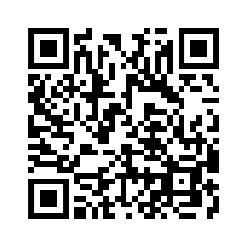
Let’s Look at Example
https://www.naftaliharris.com/blog/visualizing-k-means-clustering/
Use the tool to estimate the optimal number of clusters for the Smiley Face.

Slide 6
Outline: Intro to Unsupervised ML
What is Machine Learning?
What is exploratory data analysis?
k-means clustering
Does Congress vote in patterns?
Multi-dimensional k-means clustering
Are NBA players compensated according to performance?

Slide 7
What is exploratory data analysis?
Exploratory data analysis or “EDA” is an approach where the intent is to see what the data can tell us beyond modeling or hypothesis testing
Data visualization is one of the most common forms of EDA

Slide 8
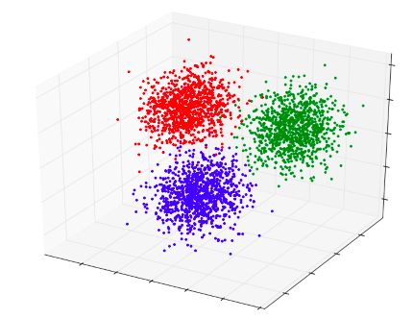
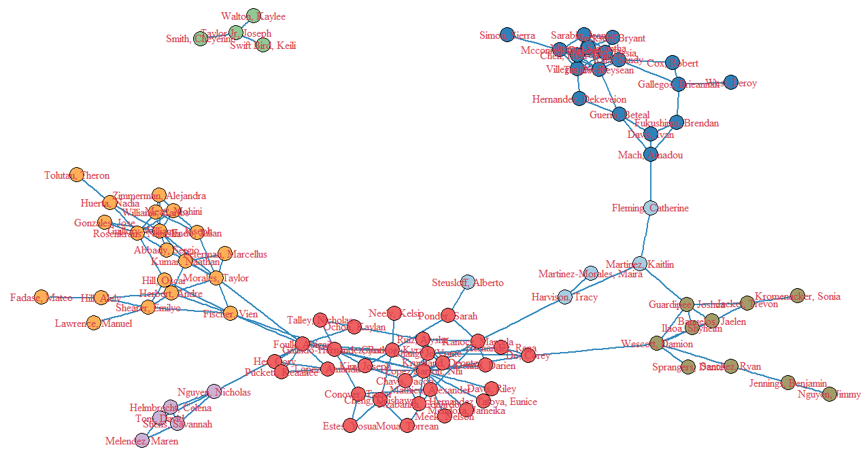
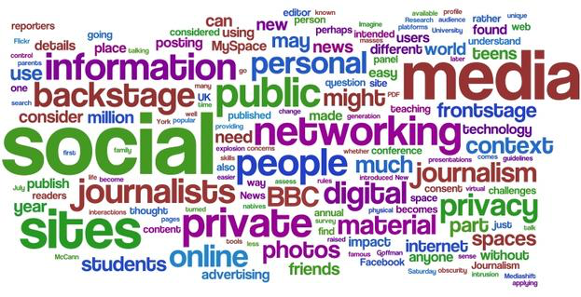
Types of exploratory data analysis
When data is too big or complex to be analyzed just by visualizing it, these types of analysis can help:
Clustering: compare pieces of data by measuring similarity among them
Network analysis: analyze how people, places and entities are connected to evaluate the properties and structure of a network
Text mining: analyze what large bodies of unstructured or structured text say

Slide 9

Unsupervised machine learning
The data inputs have (x) no target outputs (y)
?
Output y:
Not given
(To be discovered)
Input x:
Voter
We want to impose structure on the inputs (x) to say something meaningful about the data
Notes:
On the other hand, we have unsupervised machine learning.
In this case, we don’t actually know what categories we want the output to be in. So we focus on organizing and dividing the data in such a way as to show us something meaningful about the data that we might not have considered before.
Let’s assume that we have the same wine list, but in this case, we’re not sure what type of output we want. We can create categories (by region, by year, price range, type) to find out which wines cluster together, and then analyze it to find new patterns and insights.

Slide 10
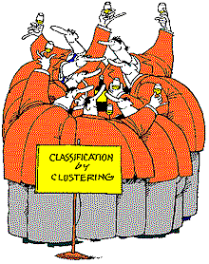
What is clustering?
Technique for finding similarity between groups
Type of unsupervised machine learning
Not the only class of unsupervised learning algorithms
Similarity needs to be defined
Will depend on attributes of data
Usually a distance metric
Key assumption: data points that are “closer” together are related or similar
Notes:
Let’s define what clustering is – we use it to find similarity between groups. It’s unsupervised because we don’t have any expected outcomes, unlike supervised machine learning.
As a note, it’s important for us to define similarity. What attributes should we use and what types of distances make the most sense?
http://www.clustan.talktalk.net/malt_whisky.html

Slide 11
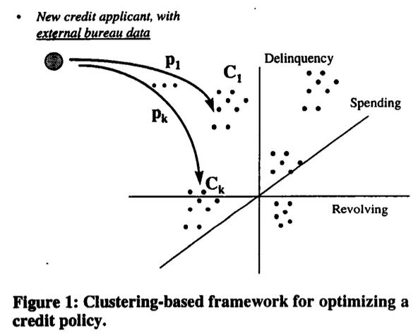
GE Capital case study: grouping clients
Haimowitz and Schwarz 1997 paper on clustering for credit line optimization
http://www.aaai.org/Papers/Workshops/1997/WS-97-07/WS97-07-006.pdf
Cluster existing GE Capital customers based on similarity in use of their credit cards to pay bills and customers’ profitability to GE Capital
Resulted in five clusters of consumer credit behavior
Created classification model to predict customer type and offer tailored products
Notes:
Let’s take a minute to look at a real-world example of how clustering is used to solve a problem.
In 1997, Ira Haimowitz and Henry Schwarz wrote a short paper about how they used clustering to separate existing credit card members into five groups by particular attributes – each group was distinct in their consumer credit behavior. How was this helpful? This led to more targeted marketing and specific offers to those groups.

Slide 12

Telenor case study: predicting behavior
Between 2001 and 2004 most European countries passed legislation that allowed customers to keep their cell phone number if they switched carriers
Telenor, one of the largest telecommunications companies in Norway wanted to ensure it kept its customers
Problem: the promotions the company sent to its clients reminded them that they could leave and resulted in greater defections!
Solution: predict which customers, if contacted, are more likely to stay with the company
Results:
Marketing campaign ROI increased 11x
Customer churn decreased 36%
Marketing campaign costs decreased 40%

Slide 13
Outline: Intro to Unsupervised ML
What is Machine Learning?
What is exploratory data analysis?
k-means clustering
Does Congress vote in patterns?
Multi-dimensional k-means clustering – Lab
Are NBA players compensated according to performance?

Slide 14
Concept summary
Example use case | General question | Concept
Does Congress vote in patterns? | Is there a pattern? Is there structure in unstructured data? | k-means clustering
Are basketball players "priced" efficiently (based on performance)? | How to uncover trends with many variables that you can't easily visualize? | k-means clustering in many dimensions
Notes:
Our first topic this week is k-means clustering, where we’ll take a look at the voting patterns in Congress.

Slide 15

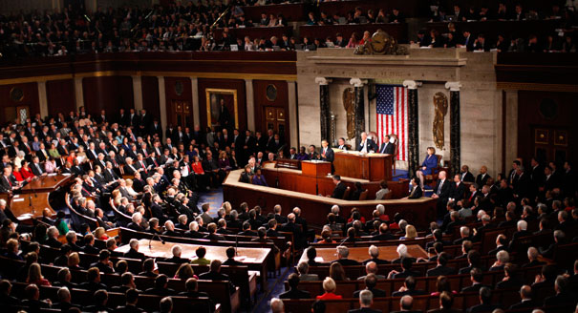
Political clustering
Goal: to understand how polarized the US Congress is
Data set consists of 427 members (observations)
Members served a full year in 2013
Three vote types:
“Aye”
“Nay”
“Other”
The joint session of Congress on Capitol Hill in Washington
Notes:
So let’s take a look at the data we’re working with. We have 427 data points (each one is a member of Congress) and this is taken from 2013. There are three types of votes: aye, nay or other (i.e. might not have voted or decided to abstain).

Slide 16
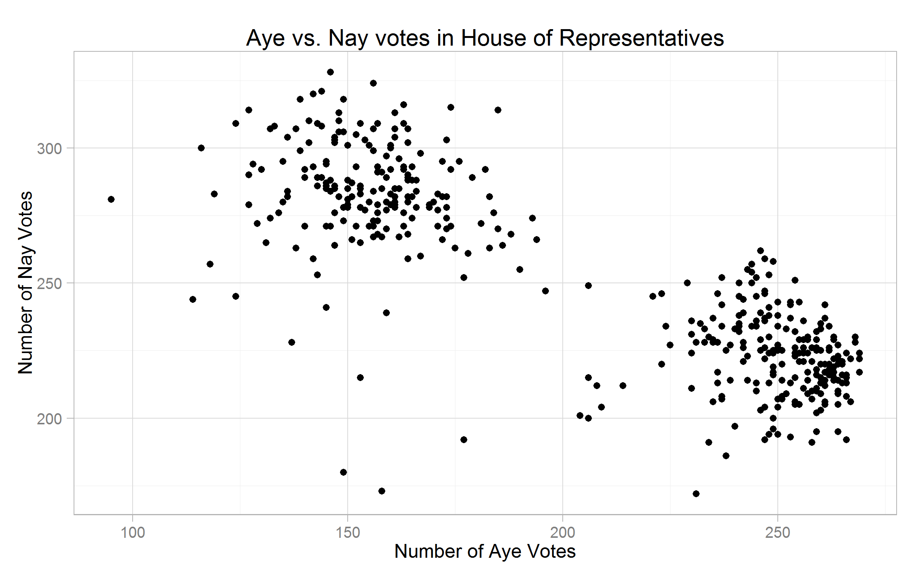
Finding voting patterns
Each data point represents a member of Congress
How do we identify swing votes?
Lobbying
Bridging party lines
Assumption:
Democrats and Republicans vote among partisan lines, which generates clusters
Notes:
Here is the graph that we get when we plug in all the points. Now, we can see that there are two fairly distinct clusters, but at this stage, we’re not sure who is a Republican and who is a Democrat. We do make an assumption that they vote along partisan lines.

Slide 17
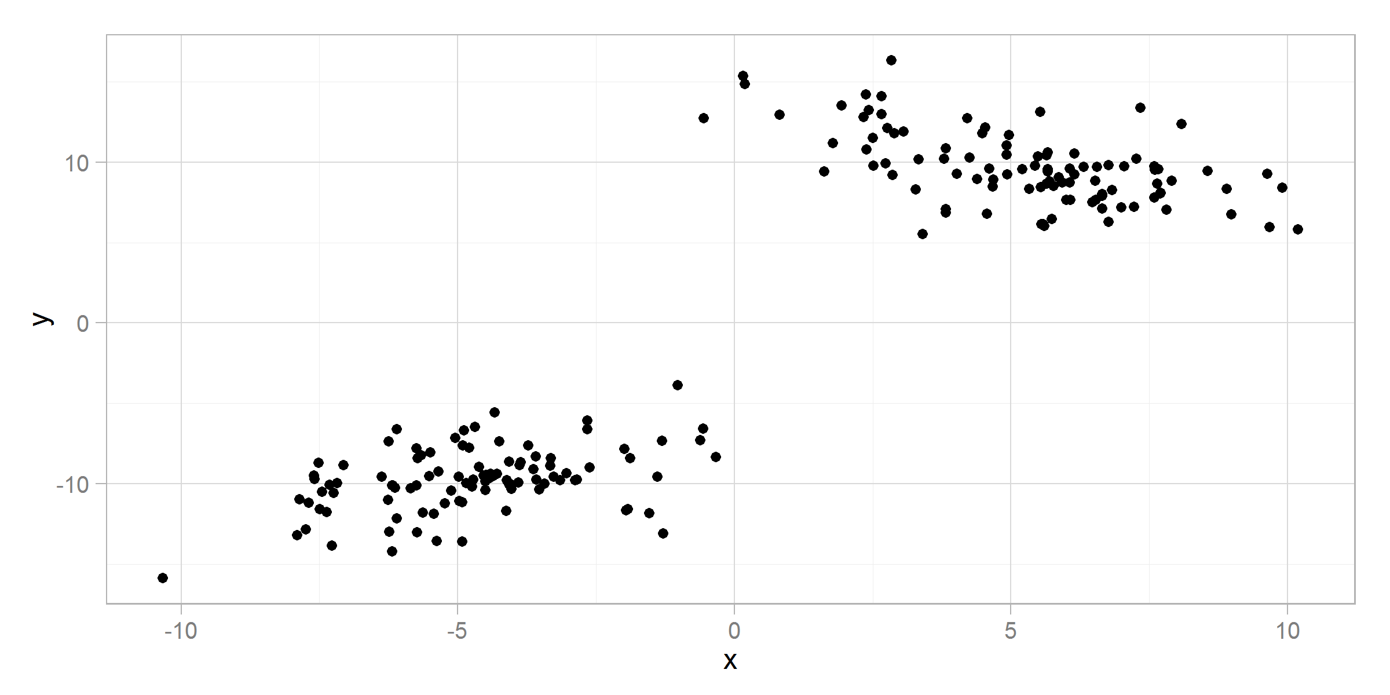
Intra vs. inter-cluster distance
Inter-Cluster Distance
Intra-Cluster Distance
Objective: minimize intra-cluster distance, maximize inter-cluster distance
Notes:
In clustering, we have two important terms: inter-cluster distance and intra-cluster distance.
Inter-cluster refers to the distance between two clusters. The larger the distance, the more distinct these clusters are. Intra-cluster distance refers to the spread of the data points within the cluster. When the average distance between points is smaller, we are minimizing the standard deviation within the cluster.
In order to create the strongest clusters, we want to minimize intra-cluster distance and maximize inter-cluster distance.

Slide 18
k-means clustering is based on centroids
The centroid is the average location of all points in the cluster
Another definition: the centroid minimizes the distance between a central location and all the data points in the cluster
Note: Centroids are generally not existing data points, rather locations in space
Notes:
We can actually find the centroids in these clusters – a centroid is the average location of all the points in a cluster, but it’s not necessarily a data point.

Slide 19
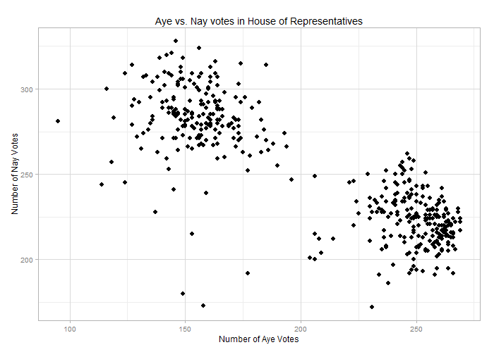
k-means in 4 steps
Randomly choose k data points to be centroids
Notes:
So how do we figure out what the best centroid is? We have to test out a few different locations until we find one that fits.
First, we pick a number of data points (k) to be the centroids.

Slide 20
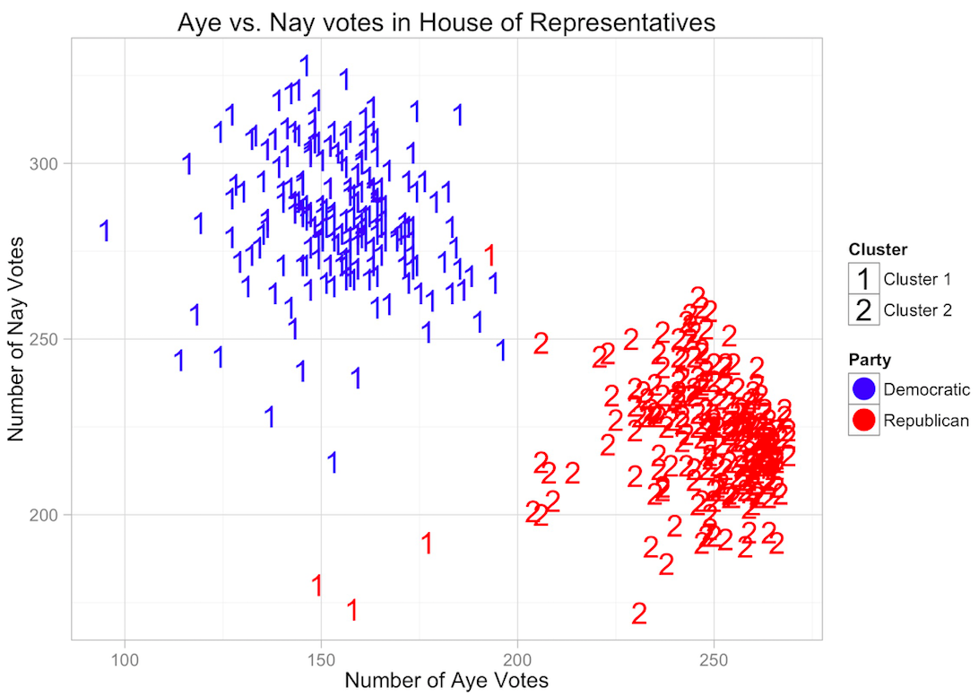
k-means in 4 steps
Randomly choose k data points to be centroids
Assign each point to closest centroid
Notes:
Next, we assign all the other data points to the closest centroid.

Slide 21
k-means in 4 steps
Randomly choose k data points to be centroids
Assign each point to closest centroid
Recalculate centroids based on current cluster membership
Notes:
Then, based on the current clusters, we recalculate the centroids to minimize the distance between that point and all the other points in the cluster.

Slide 22
k-means in 4 steps
Randomly choose k data points to be centroids
Assign each point to closest centroid
Recalculate centroids based on current cluster membership
Repeat steps 2-3 with the new centroids until the centroids don’t change anymore
Notes:
Then, we repeat steps 2 and 3 until we have stable centroids.

Slide 23
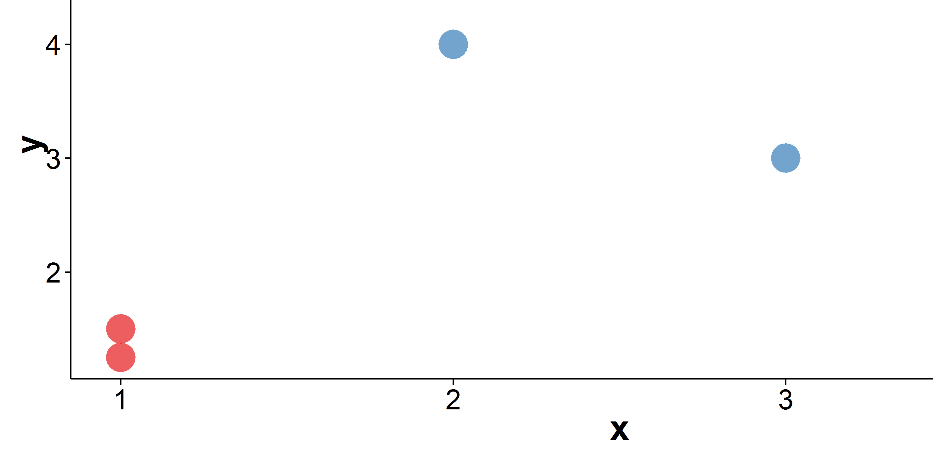
Measuring distance
Distance = √(2² + 1²)
(3,3)
1
x
(1,2)
2

Slide 24
kmeans outputs
cluster: a vector indicating the cluster to which each point is allocated
centers: a matrix of cluster centers
totss: the total sum of squares (sum of distances between all points)
withinss: vector of within-cluster sum of distances, one number per cluster
tot.withinss: total within-cluster sum of distances, i.e. sum of withinss
betweenss: the between-cluster sum of squares, i.e. totss - tot.withinss
size: the number of points in each cluster
To learn more about the kmeans function run ?kmeans
Notes:
We will talk about why we care about all these metrics shortly. In essence, they are used to measure the “quality” of the clustering that we performed, to assess if there is a better number to use for k or not

Slide 25
Intra vs. inter-cluster distance
totss = withinss + betweenss
Inter-Cluster Distance
Intra-Cluster Distance
betweenss
withinss
Notes:
In clustering, we have two important terms: inter-cluster distance and intra-cluster distance.
Inter-cluster refers to the distance between two clusters. The larger the distance, the more distinct these clusters are. Intra-cluster distance refers to the spread of the data points within the cluster. When the average distance between points is smaller, we are minimizing the standard deviation within the cluster.
In order to create the strongest clusters, we want to minimize intra-cluster distance and maximize inter-cluster distance.

Slide 26
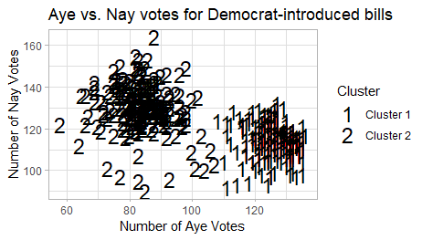
Step 3: visualize plot
Notes:
This is the plot that we get - we’ve drawn circles around the two clusters that have formed.

Slide 27
Step 4: analyze results
What can we infer about the different clusters?
Two groups exist
Algorithm identifies voting patterns
Notes:
What do we notice? Well, the algorithm identified two groups, and it seems as though there are voting patterns that emerge.

Slide 28
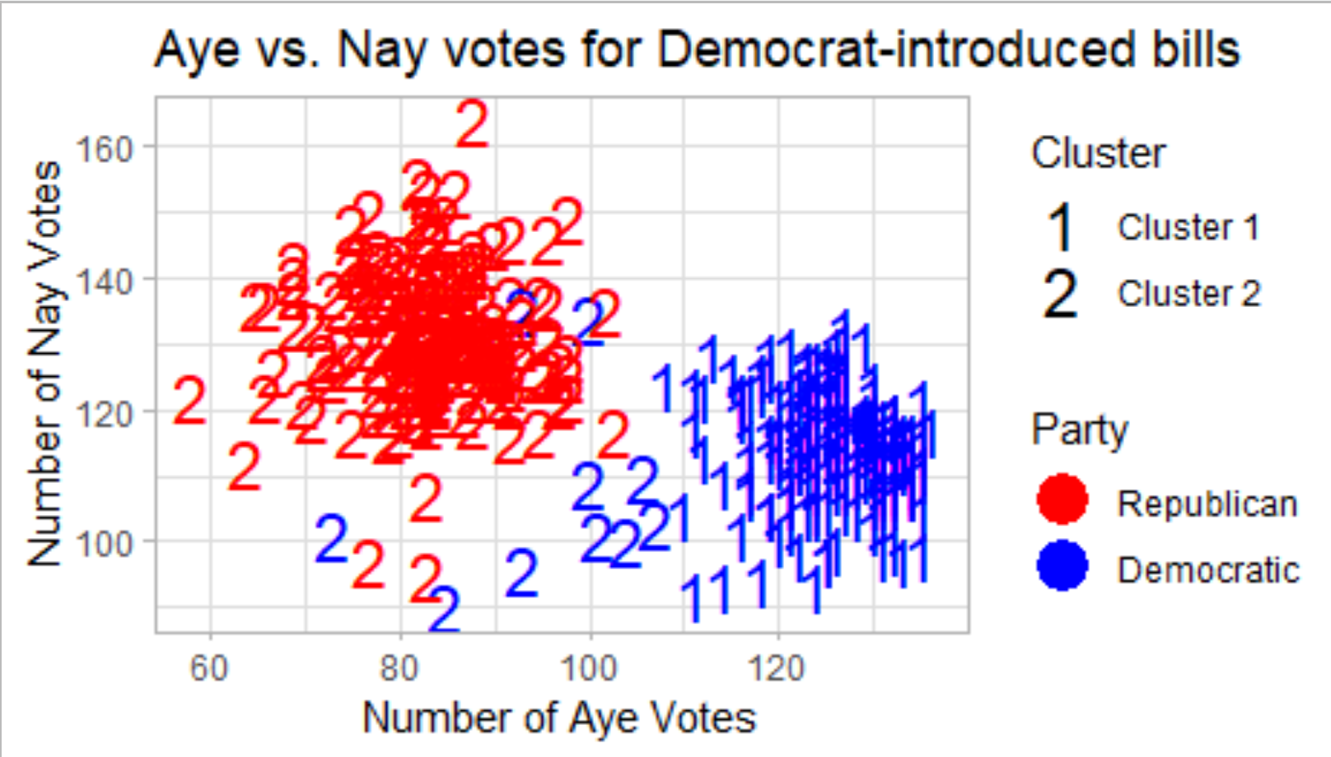
Step 5: validate results
Notes:
We can color code the points by party – Democrats are represented by blue, and Republicans are red.
What information can we extract from this graph now?

Slide 29
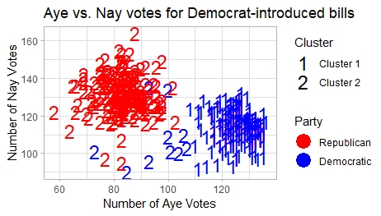
Step 6: interpret results
Diffuse among Democrats
Republicans more dense
Can gauge “outliers”
Can see the polarization between the two political parties
Outliers?
Notes:
The Democrats have more diffusion in their voting patterns than the Republicans, but at the same time, there are some Republicans who are classified as part of the Democrat cluster.
It’s an easy way for us to party members who vote differently

Slide 30
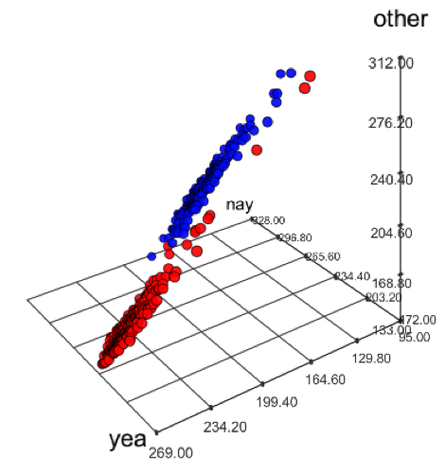
Clustering vs. visualizing
Clustering is more powerful than the human eye in 3D
Clustering mathematically defines which cluster the peripheral points should be in when it’s not obvious to the human eye
Clustering is helpful when many dimensions / variables exist that you can’t visualize at once
Whiskey similarity example from classification lecture
Aye, Nay and Other Votes
in House of Representatives
Notes:
Clustering is more powerful than visualizing because it can mathematically determine where the cluster points belong. Instead of us having to guess which points belong to which cluster, the algorithm uses many variable or dimensions to make that determination for us.

Slide 31
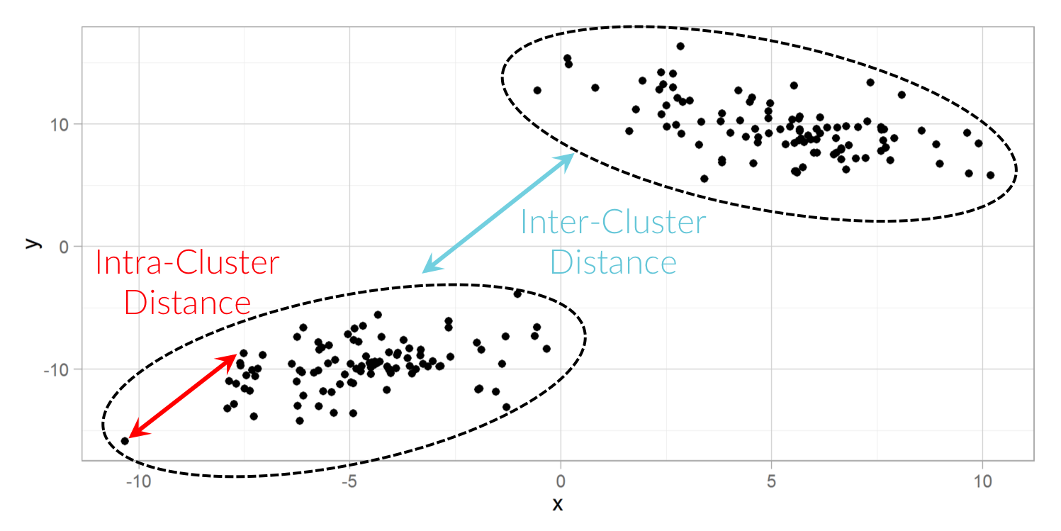
How good is the clustering?
Goals of clustering:
Maximize the separation between clusters
i.e. Maximize inter-cluster distance
Keep similar points in a cluster close together
i.e. Minimize intra-cluster distance
Notes:
Now, when we want to select the right k (number of clusters) we have to keep in mind that we are trying to find the maximum intercluster distance between clusters and minimize the intra-cluster distance.
In this way we keep similar point together and ensure similar points are maximally separated from other points that don’t fall in their group

Slide 32
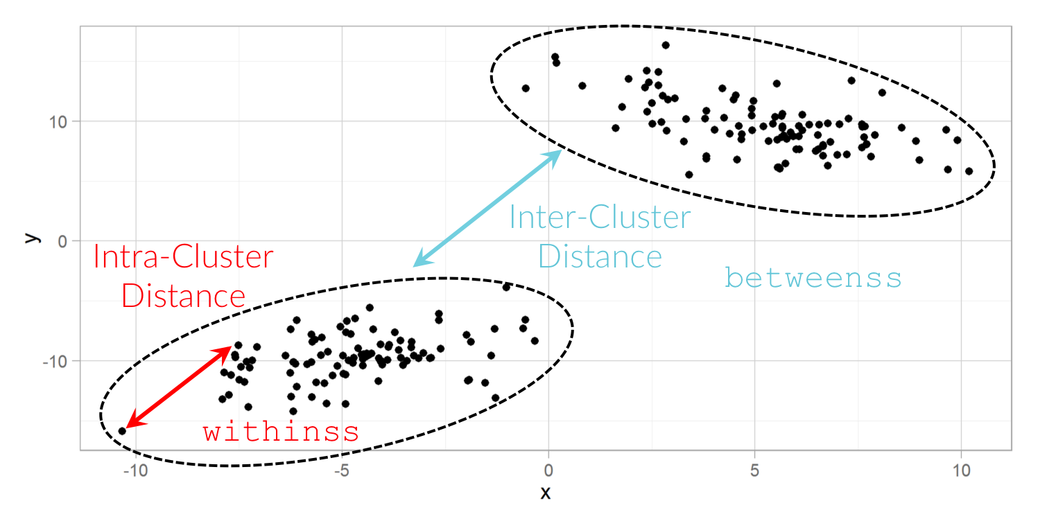
How good is the clustering?
Assessing how well an algorithm performs
Variation explained by clusters
=
inter-cluster variance / total variance
Look at the variance explained by clusters
In particular, the ratio of inter-cluster variance to total variance
How much of the total variance is explained by the clustering?
Notes:
How can we determine how the algorithm performs? We calculate the inter-cluster variance (the distance between the two clusters) and divide it by the total variance. The higher the inter-cluster distance, the more “separated” the groups are. This would also account for more of the variation.

Slide 33
kmeans outputs
cluster: a vector indicating the cluster to which each point is allocated
centers: a matrix of cluster centers
totss: the total sum of squares (sum of distances between all points)
withinss: vector of within-cluster sum of distances, one number per cluster
tot.withinss: total within-cluster sum of distances, i.e. sum of withinss
betweenss: the between-cluster sum of squares, i.e. totss - tot.withinss
size: the number of points in each cluster
To learn more about the kmeans function run ?kmeans
Notes:
We will talk about why we care about all these metrics shortly. In essence, they are used to measure the “quality” of the clustering that we performed, to assess if there is a better number to use for k or not

Slide 34
Intra vs. inter-cluster distance
totss = withinss + betweenss
Inter-Cluster Distance
Intra-Cluster Distance
betweenss
withinss
Notes:
In clustering, we have two important terms: inter-cluster distance and intra-cluster distance.
Inter-cluster refers to the distance between two clusters. The larger the distance, the more distinct these clusters are. Intra-cluster distance refers to the spread of the data points within the cluster. When the average distance between points is smaller, we are minimizing the standard deviation within the cluster.
In order to create the strongest clusters, we want to minimize intra-cluster distance and maximize inter-cluster distance.

Slide 35
How good is the clustering?
# Inter-cluster variance,
# "betweenss" is the sum of the
# distances between points from
# different clusters
num_Dem = kmeans_obj_Dem$betweenss
# Total variance
# "totss" is the sum of the distances # between all the points in
# the data set
denom_Dem = kmeans_obj_Dem$totss
# Variance accounted for by
# clusters
var_exp_Dem = num_Dem / denom_Dem
var_exp_Dem
[1] 0.7193405
Script
Notes:
Here’s the code for calculating the accuracy of the algorithm.
We label the numerator (‘num’) as the inter-cluster variance and label the denominator (‘denom’) as the total amount of variance. Then, we divide the numerator by the denominator and we get a total of 76.7% variance that is explained by the clustering.

Slide 36
How good is the clustering?
How do we choose the number of clusters (i.e. k)?
It’s easier when the number of clusters is known ahead of time, but what if we don't know how many clusters we should have?
Since different starting points may generate different clusters, we need a way to assess cluster quality as well.
Notes:
In the case that we’ve been working on, it was fairly easy to intuit that k should equal two just by looking at the graph and making that assessment. But we don’t normally have such a clear case. How do we assess which number of clusters is the best?

Slide 37
How to select k: two methods
Elbow method
Computes the percentage of variance explained by clusters for a range of cluster numbers
Plots a graph so results are easier to see
Not guaranteed to work! It depends on the data in question
NbClust
Runs 30 different tests and provides “majority vote” for the best number of clusters (k’s) to use
Notes:
There are two ways we can do this:
The elbow method measures intra-cluster variance and also variance across the whole data set.
The elbow method is heuritistic and provides a visual understanding of how many clusterings there are likely to be
2. NbClust is a function that runs 30 different tests and provides “majority vote” for the best number of k’s for us to use.

Slide 38
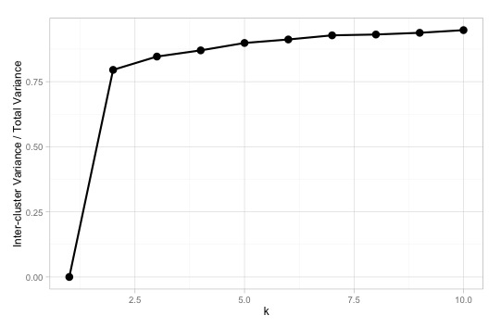
Elbow method: measure variance
Looking for the kink in graph of inter-cluster variance / total variance
k = 2
Original data
Elbow method
Notes:
When we run the elbow method, we can see that as we increase k, we increase the percent of variance that is accounted for by the clustering.
Here are the results that we get. Now, we can see that we can continue to increase accuracy as we increase the number of clusters, but is that helping us segment the data in a meaningful way?
If we think about it conceptually, we realize that eventually we will reach 100%, but that’s only when all the data points are their own cluster. That won’t help us find patterns or get insights from our data, so we need to find a balance between the most accuracy and the most useful number for k.
In this case, we see a huge spike between 2 and 3, and we can eyeball the data to see that three clusters makes sense with the data that we have.

Slide 39
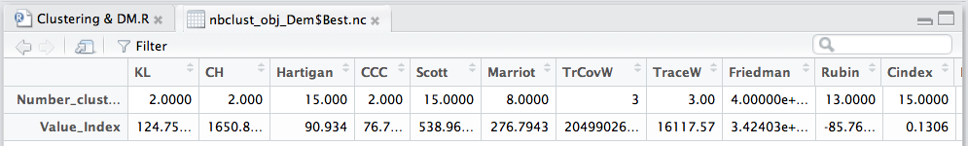
NbClust: k by majority vote
We want to visualize a histogram to make it obvious how many votes there are for each number of clusters

Slide 40
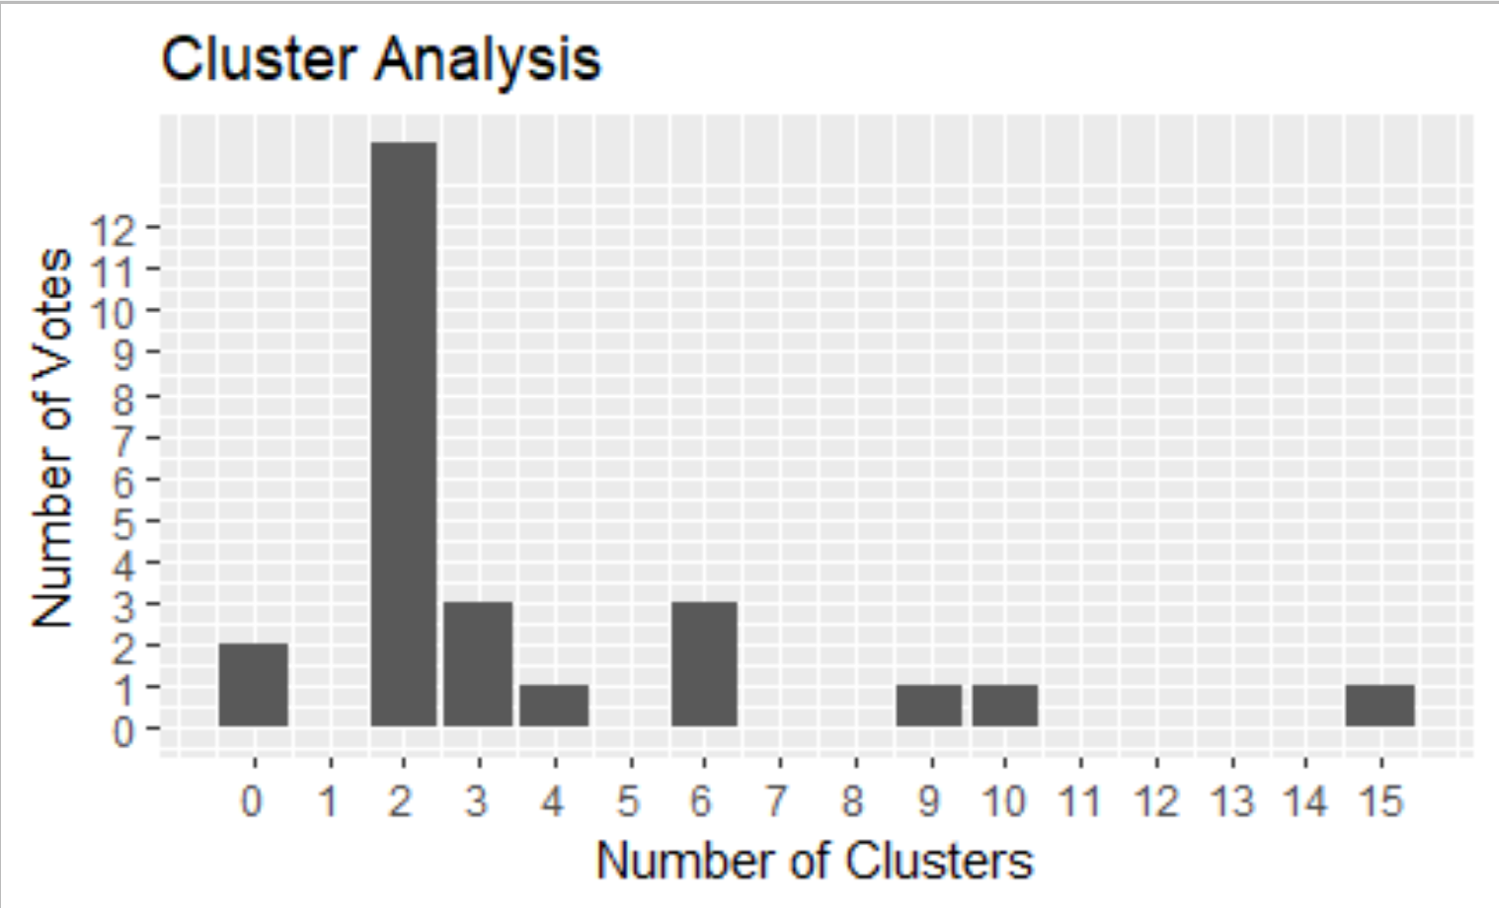
NbClust: k by majority vote
# Subset the 1st row from Best.nc and convert it
# to a data frame, so ggplot2 can plot it.
freq_k_Dem = nbclust_obj_Dem$Best.nc[1,]
freq_k_Dem = data.frame(freq_k_Dem)
View(freq_k_Dem)
# Check the maximum number of clusters.
max(freq_k_Dem)
# Plot as a histogram.
ggplot(freq_k_Dem,
aes(x = freq_k_Dem)) +
geom_bar() +
scale_x_continuous(breaks = seq(0, 15, by = 1)) +
scale_y_continuous(breaks = seq(0, 12, by = 1)) +
labs(x = "Number of Clusters",
y = "Number of Votes",
title = "Cluster Analysis")
Script
2 clusters is the winner with 12 votes
Notes:
We can take a look at the voting results (for NbClust, not for Congress) and see that 2 clearly has the most votes with this function.

Slide 41
Application of results
If you’re a lobbyist, which congressperson can you influence for swing votes?
If you’re managing a campaign and your competitor is always voting along party lines, how can you use that information?
If your congressperson is not an active voter, is she representing your interests?
What do the voting patterns look like for Republican-introduced bills?
Notes:
Here are some questions that we can answer with the results that we got from the algorithm. Of course, these are just a few of the questions that we have come up with, but there are many other applications.
In order to use this data to the fullest, we need to have that industry knowledge.

Slide 42
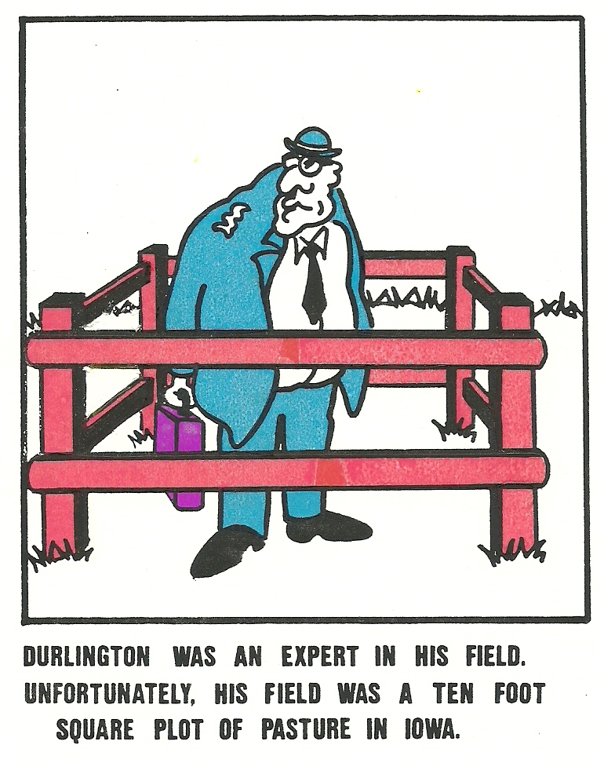
Implications of results
Could see differences between the patterns of Reb lead bills and Democrat lead bills
Could provide information on congressmen that might be see has swing votes.
Notes:
It would probably be easier for seasoned politicians and campaign managers to figure out how to use this information – that’s why domain knowledge is so important when it comes to data science. Even though we might get the same data as an expert, an expert will have a better ability to put it into appropriate context and determine how to use the results effectively.
https://cartooninc.wordpress.com/tag/daily-jokes/page/22/

Slide 43
Limitations of results
We are assuming that the patterns correspond with the same bills being voted on – perhaps some Congressmen have the same number of 'aye' and 'nay' votes, but voted on different bills
Network analysis can help determine additional connections between Congressmen
We haven't taken extenuating factors into account – political initiatives, current events, etc.
This is a preliminary analysis that gives us initial
insights and can help us direct further research
Notes:
It would probably be easier for seasoned politicians and campaign managers to figure out how to use this information – that’s why domain knowledge is so important when it comes to data science. Even though we might get the same data as an expert, an expert will have a better ability to put it into appropriate context and determine how to use the results effectively.
https://cartooninc.wordpress.com/tag/daily-jokes/page/22/

Slide 44
The good, bad, and evil
The good and bad
+ cheap – NO LABELS, labels are expensive to create and maintain
+/- clustering always works
- Many methods to choose from and knowing the right one can be nontrivial and the differences between many are almost zero, so you need to understand what you're doing
The evil
Curse of dimensionality
Clusters may result from poor data quality
Non-deterministic (e.g. k-means) subject to local minimum. Since it works with averages, k-means does not get much better with Big Data (marginal improvements)
Non spherical data may result in poor clustering (depending on method used)
Unequal cluster sizes may result in poor clustering (depending on method used)

Slide 45
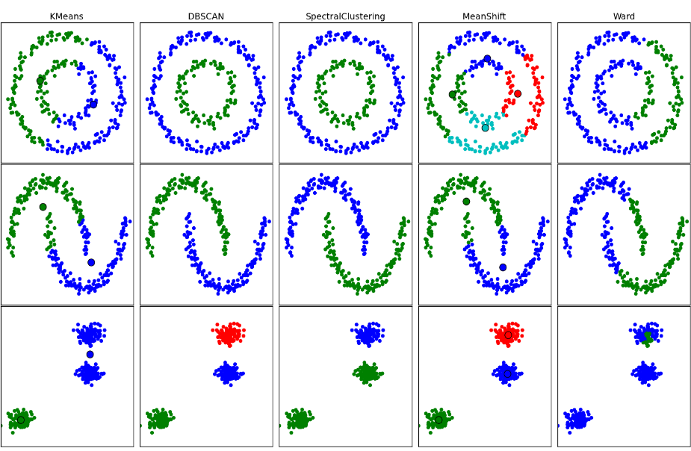

Slide 46
The good, bad, and evil
Analysts need to ask the following questions
Do you want overlapping or non-overlapping clusters?
Does your data satisfy the assumptions of the clustering algorithm?
How was the distance measure identified?
How many clusters and why? Identifying the number of clusters is a difficult task if the number of class labels is not known beforehand
Does your method scale to the size of the data?
Is the compute time congruent with the temporal budget of your business need (i.e. do you get answers back in time to make meaningful decisions)

